Slide 1

Marketing campaign

Slide 2
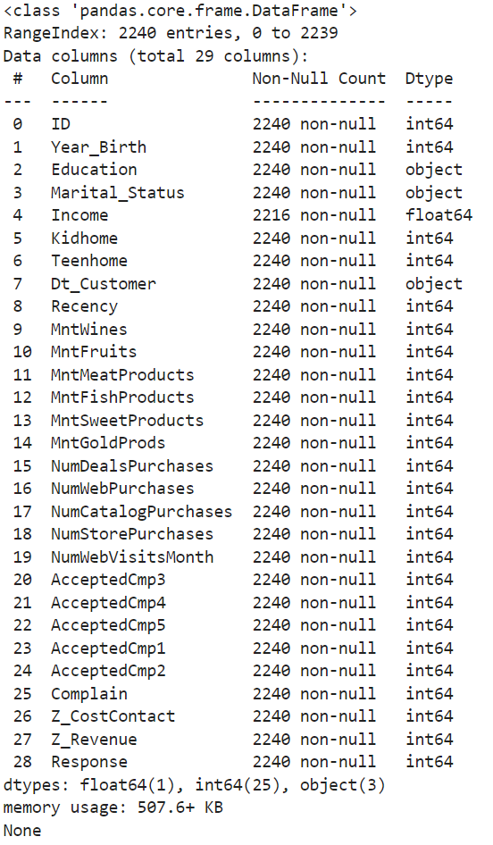
Data Information
Data contains 2240 rows and 29 columns
We have 3 categorical variables and 26 numerical variables
We have missing values for the Income variable

Slide 3
Column's description
ID: the unique identification code for every customer
Year_Birth: The Year of a customer's birth
Education: The level of education that a customer completed
Marital_Status: Status of Marriage
Income: Annual Income
Kidhome: number of children under the age of 13 in Customer's household
Teenhome: number of children between 13-19 in Customer's household
Dt_Customer: Date of Customer Enrollment
Recency: number of days since last purchase

Slide 4
Column's description
MntWines: Dollar amount of Wines purchased in last 2 years
MntFruits: Dollar amount of Fruits purchased in last 2 years
MntMeatProducts: Dollar amount of Meat products purchased in the last 2 years
MntFishProducts: Dollar amount of Fish products purchased in the last 2 years
MntSweetProducts: Dollar amount of Sweet products purchased in the last 2 years
MntGoldProds: Dollar amount of Gold products purchased in the last 2 years
NumWebPurchases: # of purchases made through the company's website
NumCatalogPurchases: # of purchases made using the catalog
NumStorePurchases: # of purchases made directly in-store
NumWebVisitsMonth: # of visits made through company's website
NumDealsPurchases: # of purchases made with discount

Slide 5
Column's description
AcceptedCmp1: 1 if customer accepted the offer in the 1st campaign, 0 otherwise
AcceptedCmp2: 1 if customer accepted the offer in the 2nd campaign, 0 otherwise
AcceptedCmp3: 1 if customer accepted the offer in the 3rd campaign, 0 otherwise
AcceptedCmp4: 1 if customer accepted the offer in the 4th campaign, 0 otherwise
AcceptedCmp5: 1 if customer accepted the offer in the 5th campaign, 0 otherwise
Complain: 1 if customer complained in the last 2 years, 0 otherwise
Response: 1 if customer accepted the offer in the last campaign, 0 otherwise
Z_CostContact: this is related to the campaign cost
Z_Revenue: This is related to the campaign success rates

Slide 6
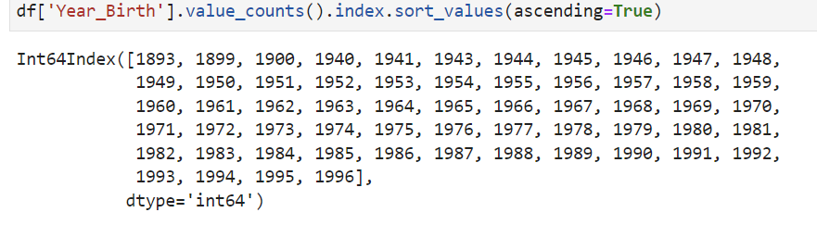
Year of Birth
Features Engineering
The feature 'Year_Birth' represents the different years of birth of the customers. The data collected contains some gaps in this feature, in terms of years in which customers were born. So, our data does not contain all the years starting from 1893 to 1996.

Slide 7
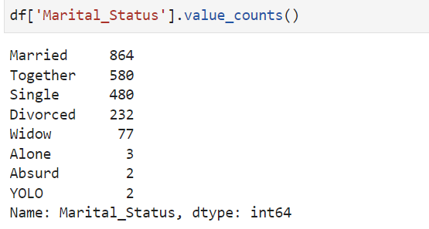
Marital_Status
Features Engineering
The Marital_Status feature has 8 classes, with similarity of meaning between the classes, so for a better representation purpuse we will replace 'Alone', 'YOLO' and 'Absurd' by 'single' .

Slide 8
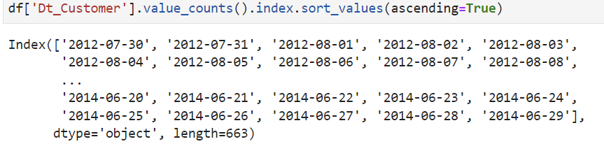
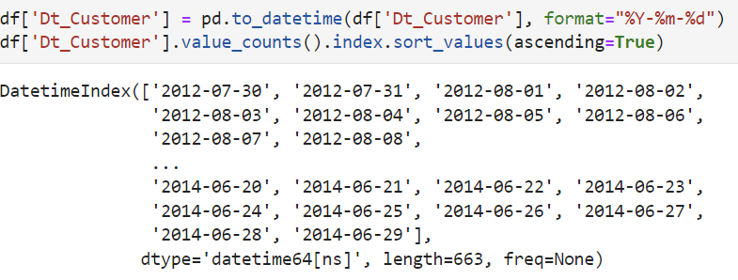
Dt_Customer
Features Engineering
The feature Dt_Customer represents dates of customer’s enrolment with the company. The data in this feature is represented in type str. In order to improve the value representation of this feature, and to do meaningful feature engineering with this feature, we will be converting the values in this feature to data type datetime.

Slide 9
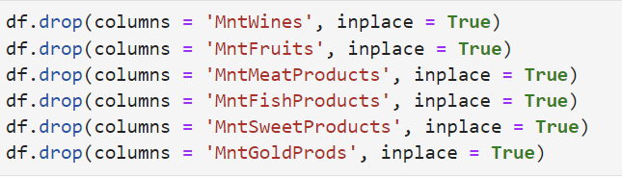
Features Engineering
Creating spending feature
Variable Spending as the sum of the amount spent on the 6 product categories

Slide 10
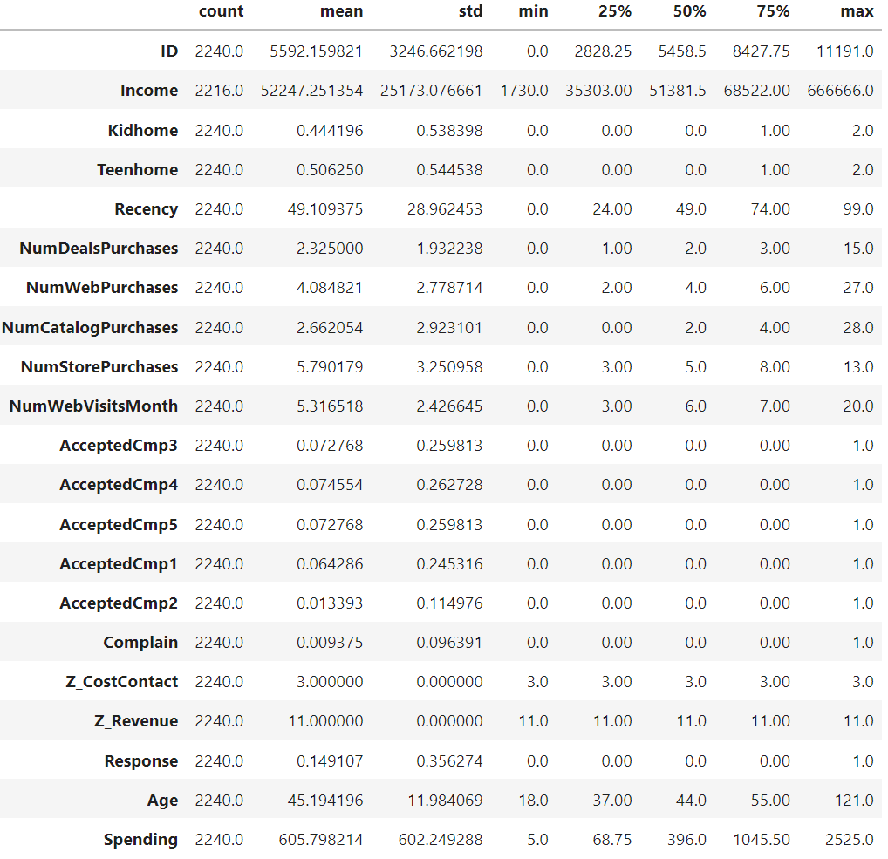
Numerical Data
Statistical summary
Average income is 52247 dollars while median income is 51300 dollars. The distribution is right skewed with the possible presence of outliers
The maximum value being equal to 666666 dollars and the 3rd quartile being only equal to 68522 dollars reinforce this hypothesis
Average spending in the last 2 years is 600 dollars while median spending is 396 dollars
Average age is 45 years old, and the oldest customer is 121 years old which is a pretty (and beautiful) rare event

Slide 11
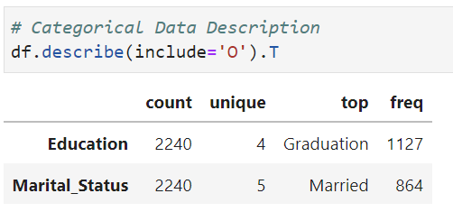
Categorical Data
Statistical summary
The majority of the sample are with a graduate level
Most of the sample are marries

Slide 12
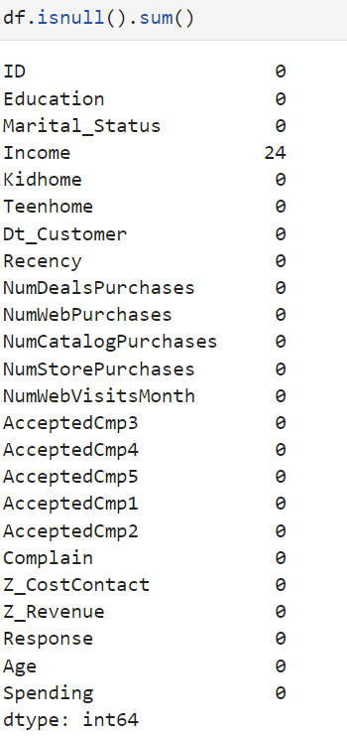
Checking for messing values
We can see that the data is fairly oh high quality since very a smaller number of missing values are present in the data. Given that, we do see 24 missing values in the feature 'Income’.
The best ways to impute the missing values in this feature, is strategies which utilize relative imputation strategies. For example, we can use the mode of the feature for imputation purposes of the missing values in this feature if we assume that the data is a high degree representation of the bigger population, which means that any new data point will be in line with the distribution of the data we have.

Slide 13
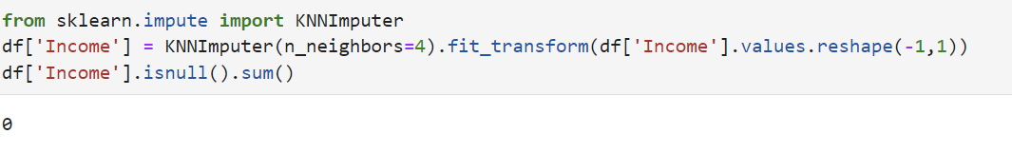
Imputation of missing values
We can use the sklearn.impute.KNNImputer for imputation purposes of the missing values in this feature, which utilizes the K-nearest-neighbors algorithm to figure out the value with highest probability and uses it for imputation.
Because of the fact we cannot be sure of how representative our data is of the larger population; we will be using KNNImputer in this case.

Slide 14
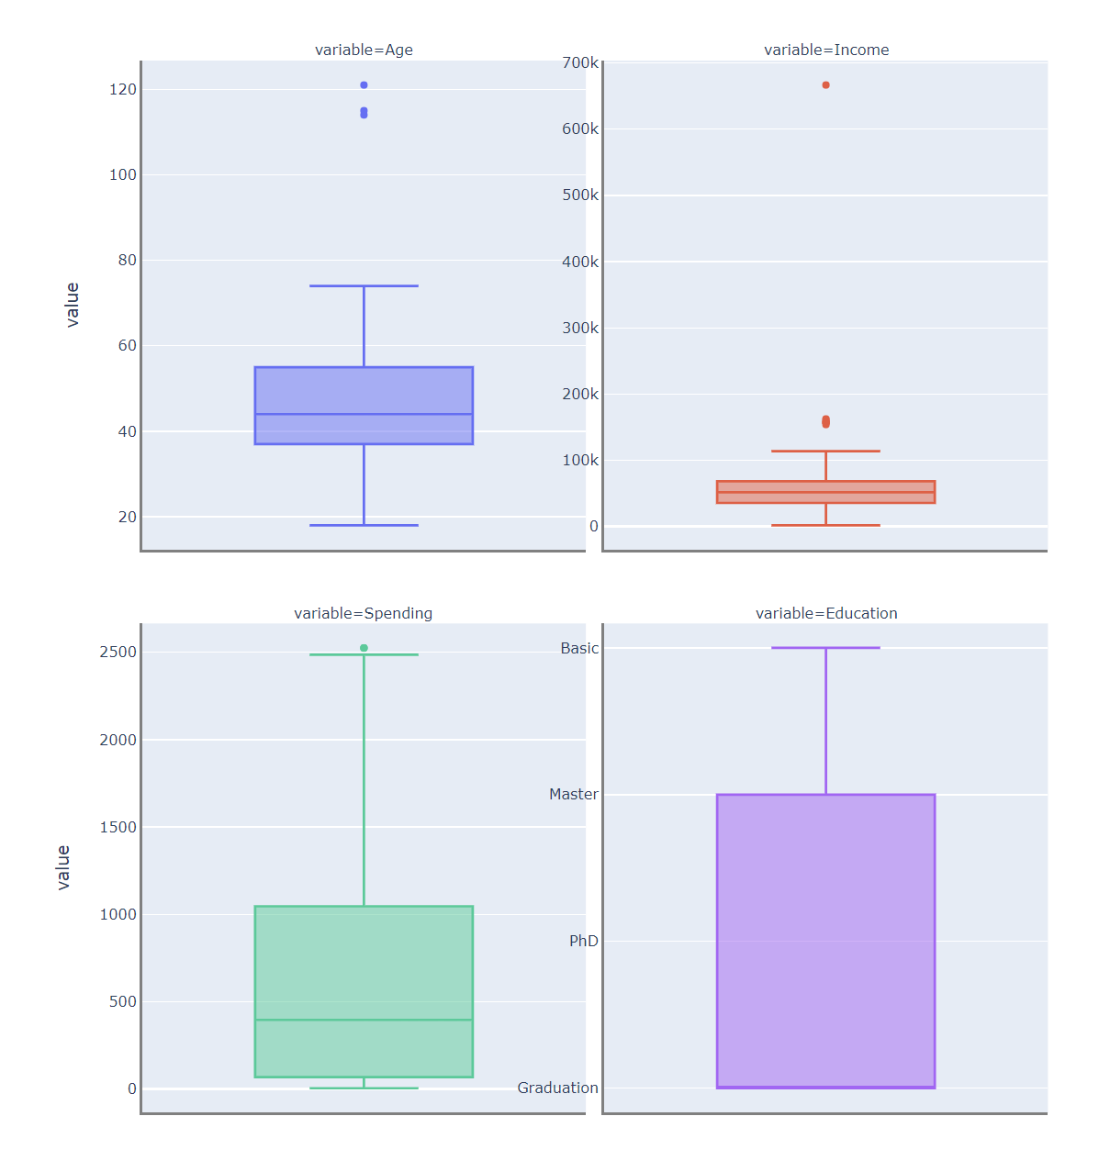
Checking for outliers
Age: 3 customers older than the Upper Fence set at 74 years old. We will not remove them
Income : Several value are greater than the Upper Fence of 113K. While having an income of 150k is not impossible, we will remove the customer who has an income of 666k (Moreover, this observation is defined as an extreme outlier based on our definition stated previously)
Spending : There is only one outlier which is at the limit of the Upper Fence. We will not remove it

Slide 15
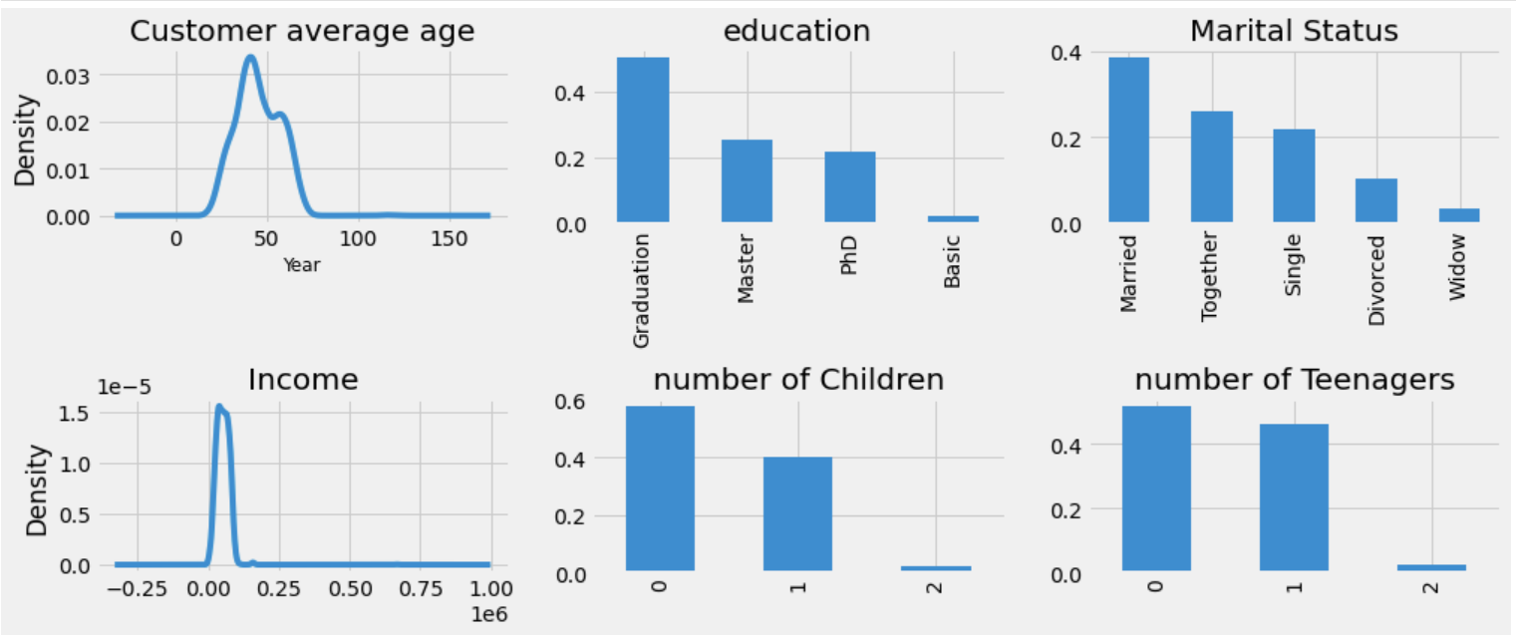
Data dashboard
From the dashboard we can see that the profile of the studied customer's simple is between 25 and 80 years old, the majority has a university degree, about 40% are married and 25% are in a relationship
40% are with children older than 13 years old
60% of the simple has between average and above the average income

Slide 16
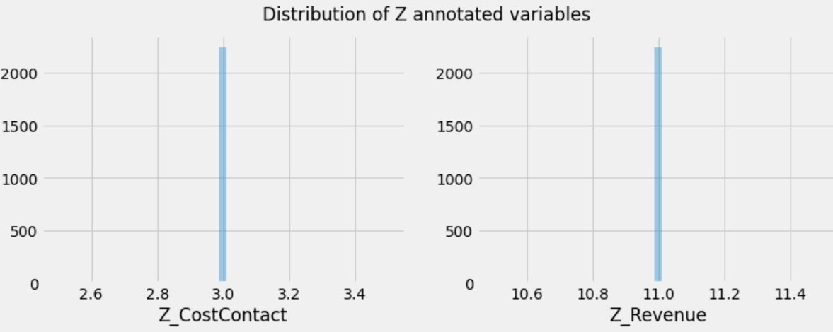
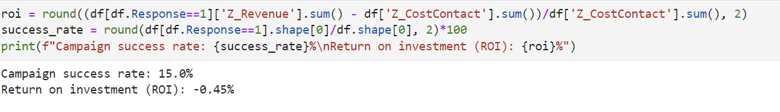
Identifying out of scope variables
The Z variables are related to the campaign costs and success rates.
The campaign success rate and return of investment can be calculated through them.
The Z variables give general idea about the campaigns success which shows that the used campaigns failed as they have a negative ROI
The Z variables will not be used for this analysis just to give a general idea for the ROI, we will drop the Z features for the rest of the study

Slide 17
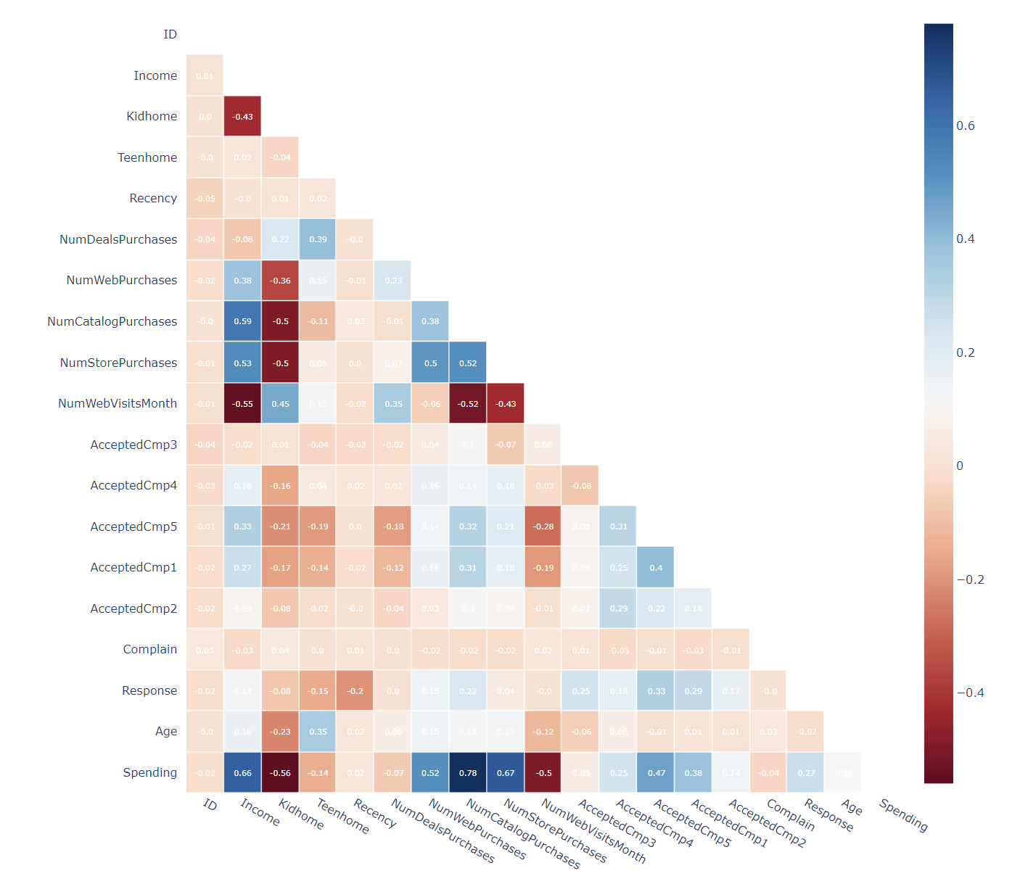
Correlation matrix
We can see from above that a lot of values in the heat map representing the correlations between the features are null values (excluding the diagonal values); this is due to the presence of imbalanced data in some of the features in our data which basically leads to 0 variance, resulting in a null value for correlation with those features.

Slide 18
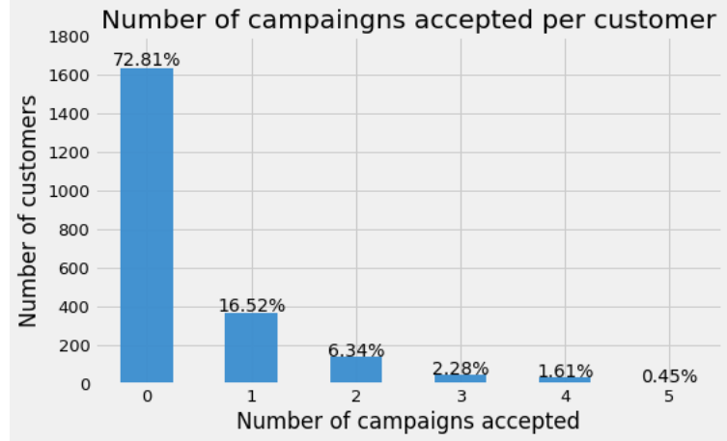
Campaign acceptance rate
From the plot we can notice that:
73% of the customers didn't accept any campaign
27% of the customers accepted at least one campaign
→ And there is a few number of customers which accepted all the campaigns, 10 customers to be exact

Slide 19
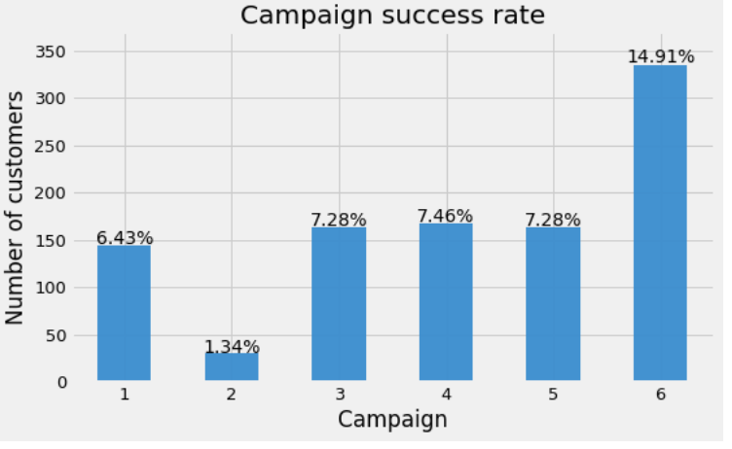
Campaign success rate
From the plot :
The last campaign was the most successful in terms of customer adhesion, doubling last campaigns success rate.
Campaign 2 was the worst one with 1.34% customer adhesion

Slide 20

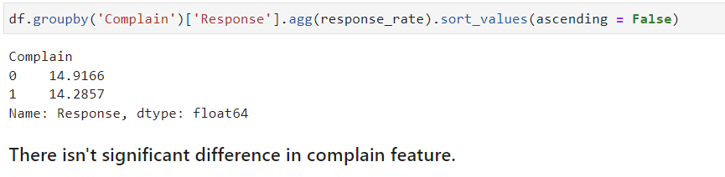
Features effect on consumer's responses
Complaint effect on response rate

Slide 21
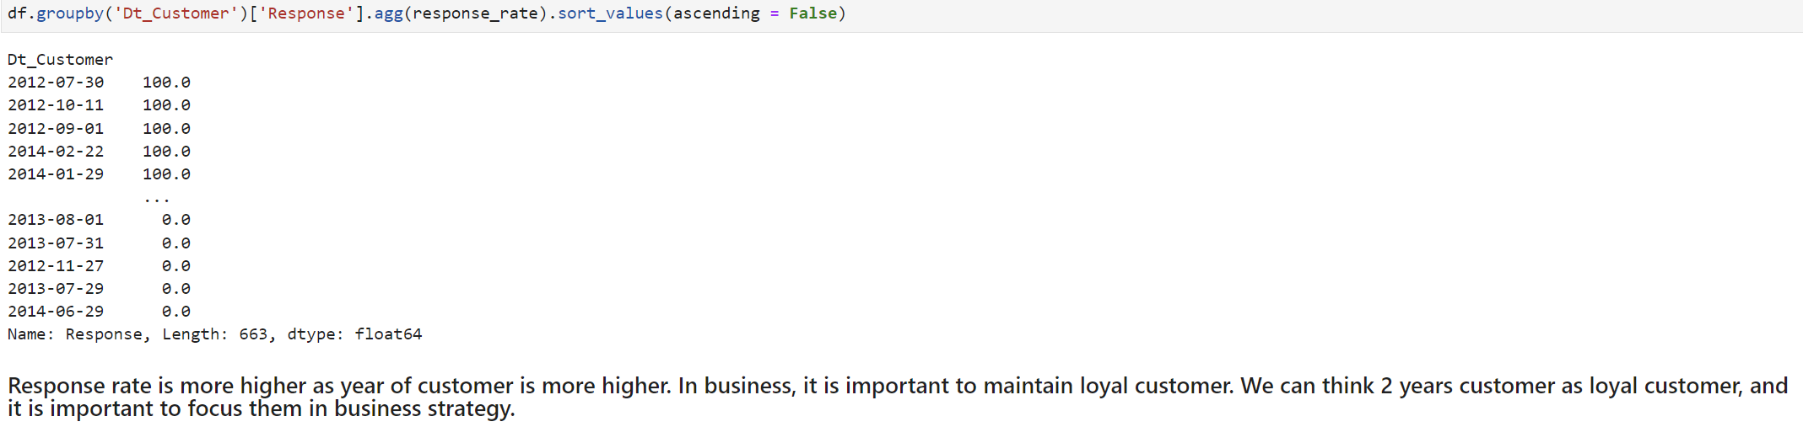
Features effect on consumer's responses
Date of customer enrollment effect on response rate

Slide 22
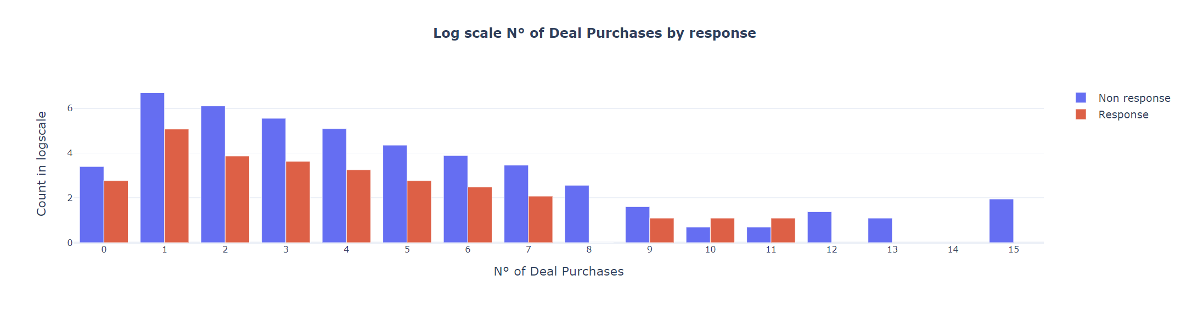
Features effect on consumer's responses
Number of deal purchases effect on response rate
Response rate is higher in 0, 9, 10, 11 deal purchases. But in 12, 13, 15 deal purchases group never response to marketing campaign. So, we need to make strategy for lower deal purchase and highest deal purchase groups.
Most active response group is 0, 9, 10, 11 and need focus group is 8, 12, 13, 14, 15.

Slide 23
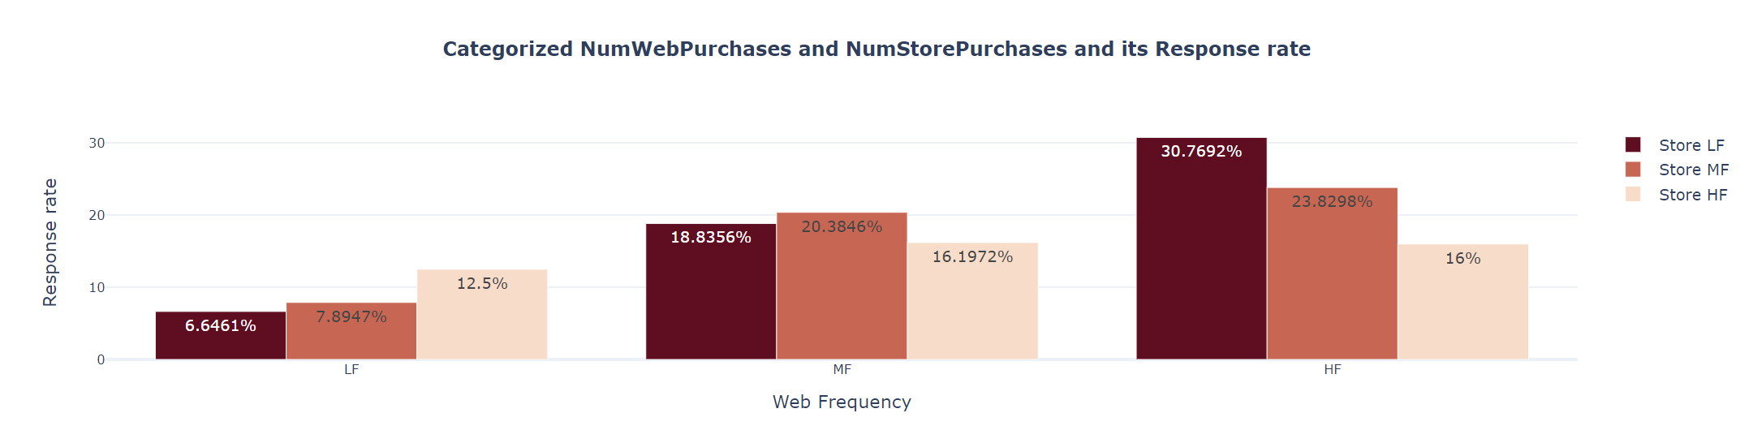
Features effect on consumer's responses
Response group is active in high frequency Number of Web Purchases and low frequency Number of Store Purchases, and non active in low frequency Number of Web Purchases and low frequency Number of Store Purchases. It might be most marketing campaign occurs on Web and E-commerce.

Slide 24
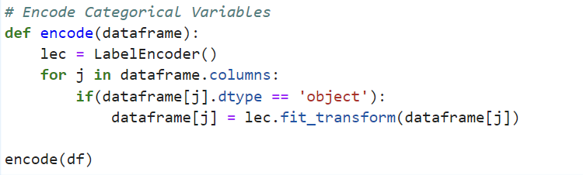
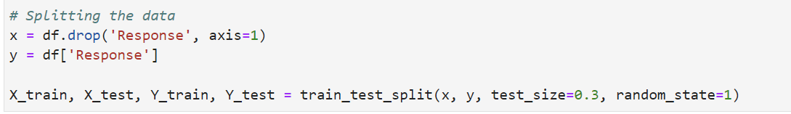
Base Line Model

Slide 25
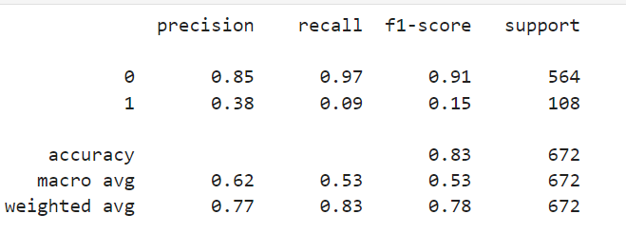
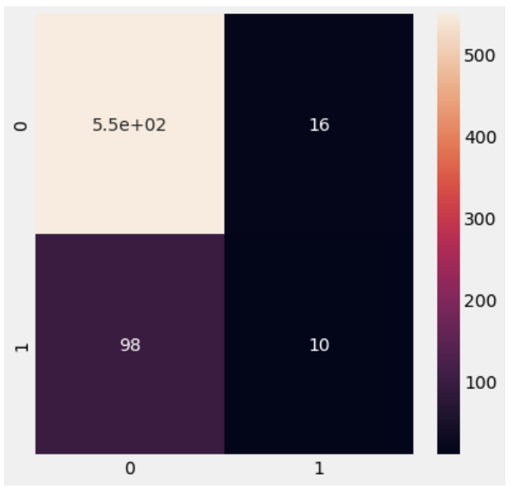
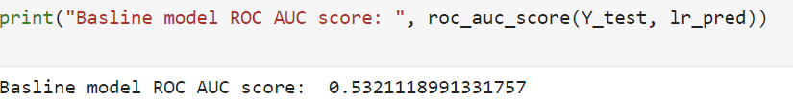
Logistic Regression
Prediction report
Confusion matrix
ROC Score

Slide 26
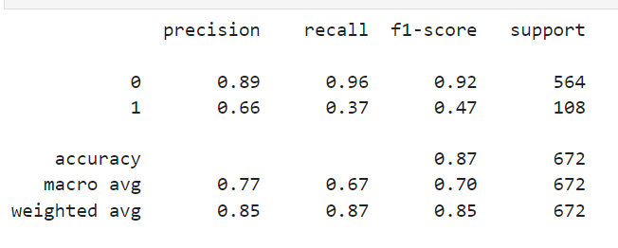
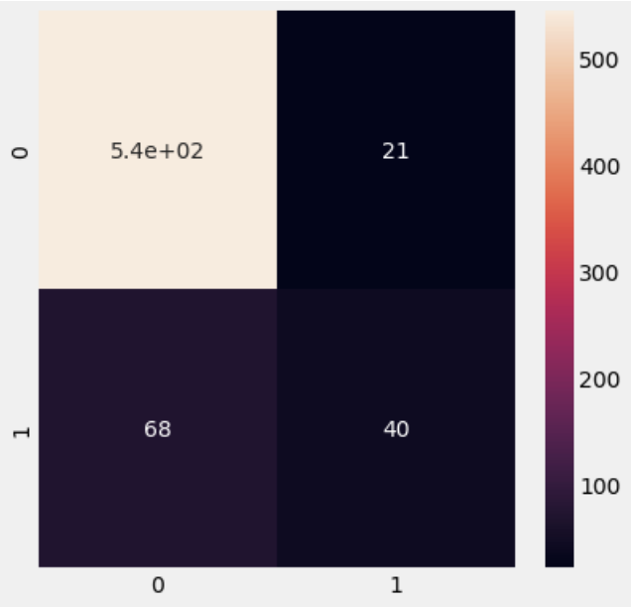

Random Forest Classifier
Prediction report
Confusion matrix
ROC Score

Slide 27

Thank you for your attention

